Slide 1
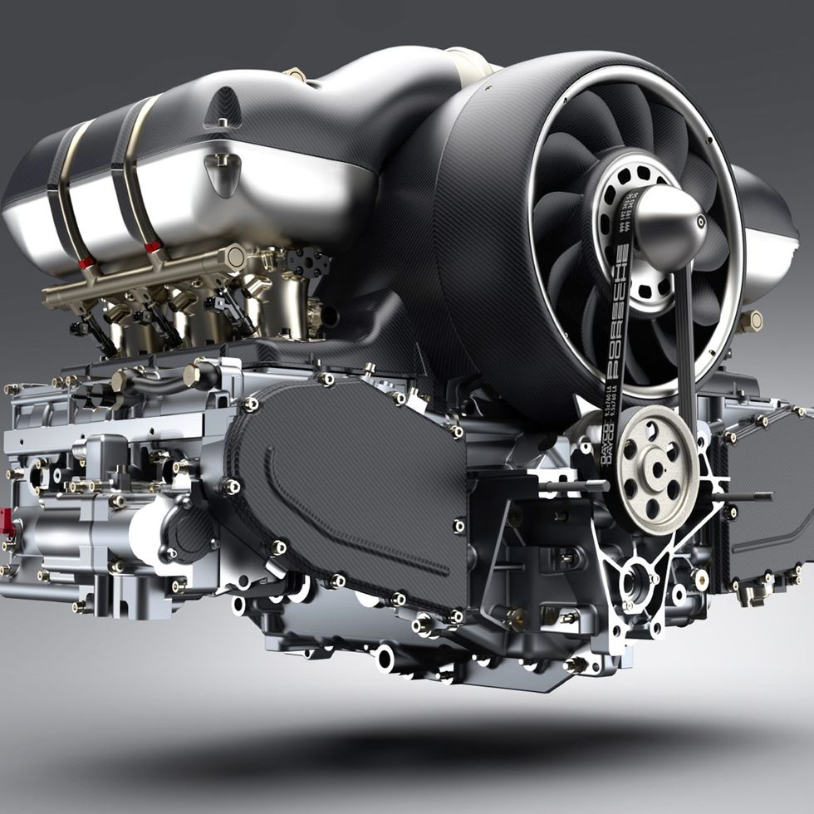
Predictive Maintenance of engines using IBM Cloud
Team Members:
Bhavya sai
Vaishnavi
Sadhana
Sampurna latha
Vasreya

Slide 2
INTRODUCTION
Predictive maintenance is the asset management practice of repairing an asset or piece of equipment before it fails based on data received about it. It is the third phase in asset management
Corrective maintenance: repairs made after a problem or failure occurs
Preventative maintenance: scheduled repairs made based on experience
Predictive maintenance: repairs made because data for an asset indicates that a failure is imminent

Slide 3
Why is predictive maintenance important?
Fixing something before it breaks is more efficient and cost-effective than fixing it after it breaks. It helps…
Avoid downtime and improve productivity
Extend the life of assets and defer new purchases
Reduce the cost and complexity of repairs
Mitigate additional or related damage
Meet regulatory standards and compliance
Manage spare parts, materials and inventory
And ultimately, boost the bottom line

Slide 4

STATEMENT:
Predictive Maintenance of engines using IBM Cloud

Slide 5
SOLUTION:
Predictive maintenance is the practice of determining the condition of equipment in order to estimate when maintenance should be performed — preventing not only catastrophic failures but also unnecessary maintenance, thus saving time and money.

Slide 6
THANK YOU

